Slide 1
The C0de Diaries
What is a C0de Diary?
For experienced software developers
Technical topics condensed into intense slides
Each deck not more than 15 slides
Acts as companion to WWW information and reference books
Also serves as a refresher resource for a crash course

Slide 2
August 2013 - Contents
Spring MVC overview
RESTful web services in JAVA using Spring

Slide 3
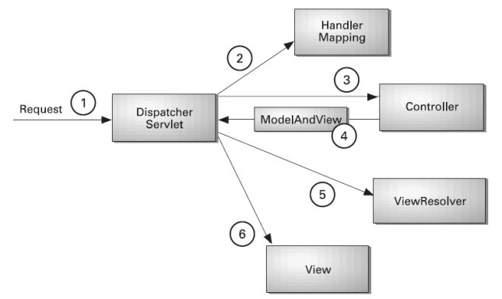
Spring MVC Overview-1
Maps requests to actions
2. Invoke action/ get
data
1. http request
Browser or other client
Controller
3. Action o/p
5. Rendered page/response
4. Generate req
view
Model
View
Jsp/asp, presentation layer tech
Data model and business logic
General MVC pattern details
MVC high level stuff in Spring

Slide 4
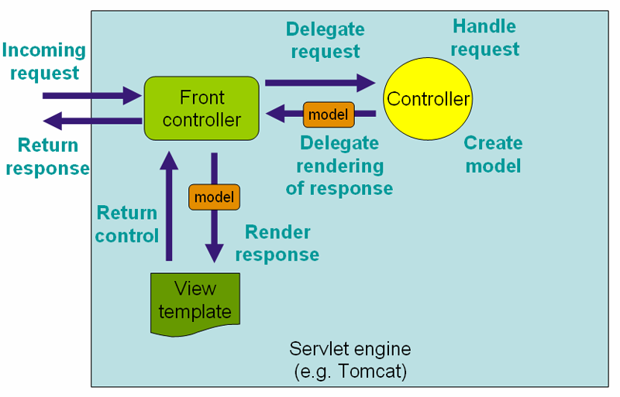
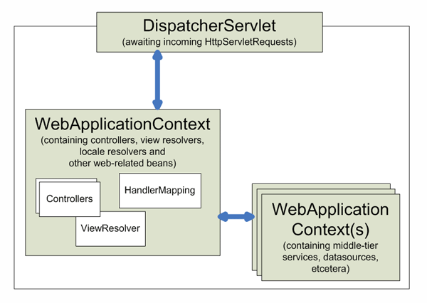
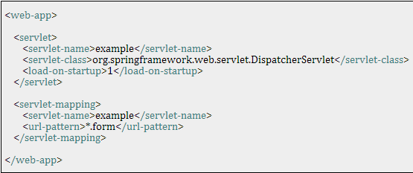
Spring MVC Overview-2
3
4
Request processing workflow
10
5
1. Incoming request
7
6
9
8
2
Context hierarchy
‘example’ webapp will handle
these requests
3
Mapping DispatcherServlet to your webapp
http://blog.springsource.com/2011/01/04/green-beans-getting-started-with-spring-mvc/

Slide 5
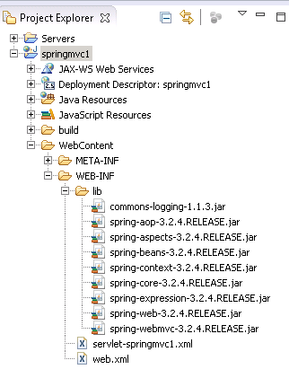
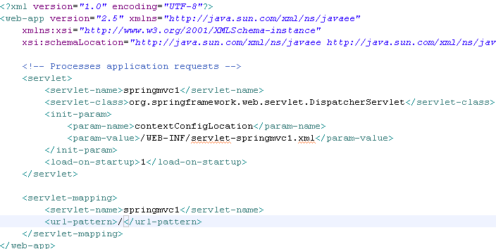
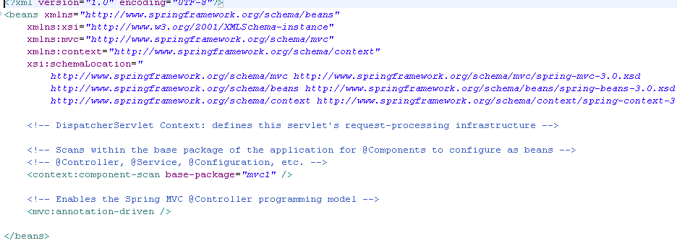
Spring MVC Overview - 3
Need to copy these in web-inf/lib
URL for this is - http://localhost:8080/springmvc1/

Slide 6
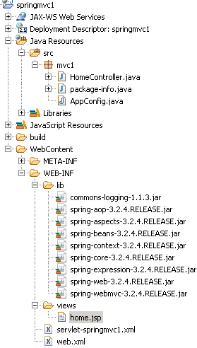
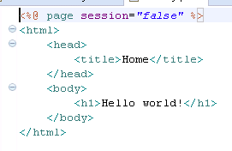
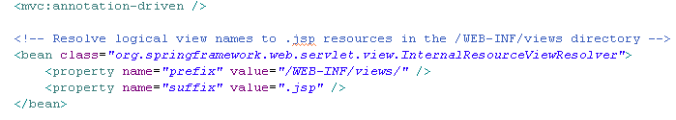
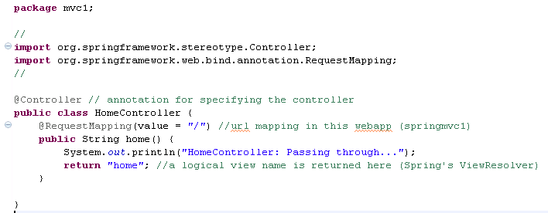
Spring MVC Overview-4
View for ‘home’
View Resolution mechanism 1 – via config in xxx-servlet.xml. Can do this via code too.
Controller
Code that refers to the view

Slide 7
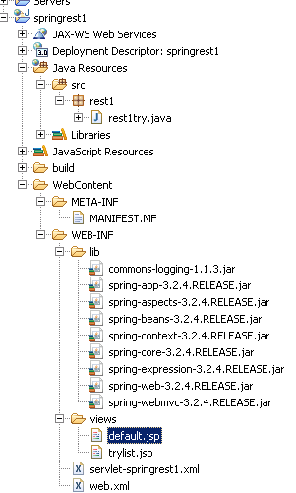
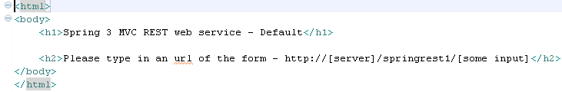
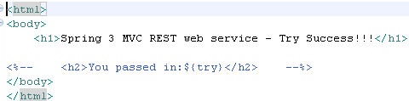
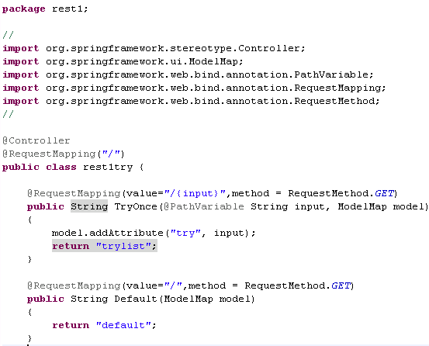
Spring MVC3 RESTful services-1
Default.jsp
Trylist.jsp
Controller class
For default view - URL for this is - http://localhost:8080/springrest1/
For other URL is - http://localhost:8080/springrest1/<some input>
Web.xml and servlet-xxx.xml are similar as shown on the previous slides.

